Slide 1
Learning outcome
To explore the elements of your chosen texts that you can compare/contrast.

Slide 2
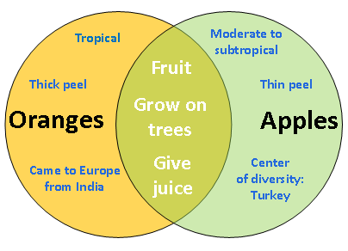
Compare and contrast
What do these two words mean to you?

Slide 3
Making notes
What genre/s are you looking at in the text?
What methods of writing is the author using within these genres?
What contextual matters need to be considered? (remember production and reception)
What potential meanings are being made in the text?
Is it possible to interpret the text in different ways?
Have a go at making notes on these two texts using the numbered points above.

Slide 4
Genre
Extract 1?
Parody of a travel book, outsider commenting on their travels
Political satire
Extract 2?
Novel
Fictional and “real” characters

Slide 5
Methods of writing?
Extract 1
First person
Contrast between what Gulliver says and what we understand
Satirical (method of writing which ridicules and exposes human weaknesses)
Reader’s sympathies lie elsewhere than with the narrator
Extract 2
In episodes; developing plot
Satirical
Third person narrator; distance created; lack of detailed thought; colloquial

Slide 6
Context
Extract 1
Author’s political position
Power structures of the time
Why are we still reading this book – aspects of power which are still present today?
Extract 2
Contemporary – production and reception merge
Is this about the 2010 Labour govt or any government?

Slide 7
Potential meanings?
Extract 1
Ironic method e.g. “extraordinary care” taken in educating the nobility – he means the exact opposite
Extract 2
Obvious meanings?
Current events echoed e.g. overuse of statistics; failure of govt agencies; search for policies

Slide 8
Interpretation
Extract 1
Author judging all mankind harshly?
Judgements are often based on poor evidence?
Not all mankind – the govt at the time?
Extract 2
Should we sympathise with the Prime Minister or is he to be simply ridiculed?
Simply comic? Not very subtle?

Slide 9
Areas of comparison/contrast?
Satire on government
Contrasting narrative methods
Contrasting contexts of production and reception
On surface broad comparative meanings – at a deeper level the texts differ greatly in their levels of meaning and effect

Slide 10
Task and title
After you have outlined comparative/contrasting points you need to construct your task/title
Ideas for the two extracts?
Compare and contrast the ways in which Swift and Townsend present aspects of power and politics
Is it fair to say that Swift is more interested in serious concerns and Townsend more interested in comedy?
Swift was writing in 1726, Townsend in 2006. To what extent does their satire share common concerns and how is it different?

Slide 11
What things must you consider in creating your task?
Must be able to address all AOs:
Author’s techniques (AO2)
Possible meanings (AO3)
Relevant contexts (AO4)

