Slide 1
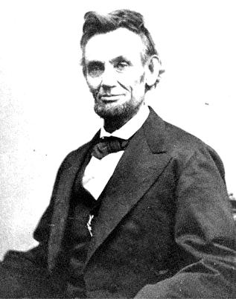
Thinking about context (AO4) What do you think American ideals are based on?
We hold these truths to be self-evident, that all men are created equal, that they are endowed by their Creator with certain unalienable Rights, that among these are Life, Liberty and the pursuit of Happiness.
The Declaration of Independence was the statement adopted by the Continental Congress on July 4, 1776, which announced that the thirteen American colonies, then at war with Great Britain, regarded themselves as independent states, and no longer a part of the British Empire.

Slide 2
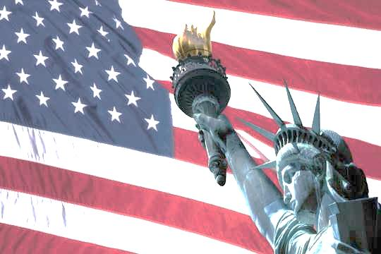
Thinking about context (AO4)
“Life should be better and richer and fuller for everyone, with opportunity for each according to ability or achievement."
(James Truslow 1931)
The American Dream is a national ethos of the United States; a set of ideals in which freedom includes the opportunity for prosperity and success, and an upward social mobility achieved through hard work.

Slide 3
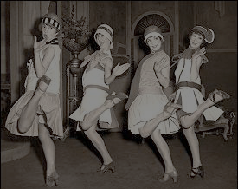
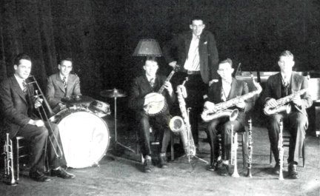
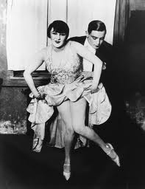
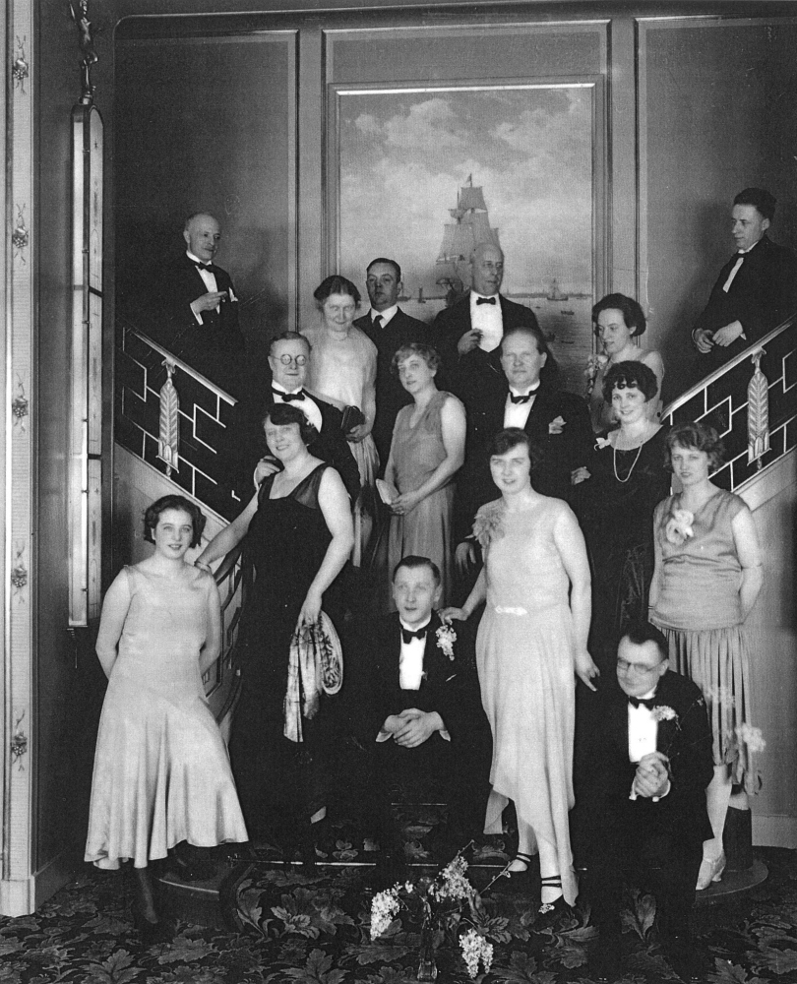
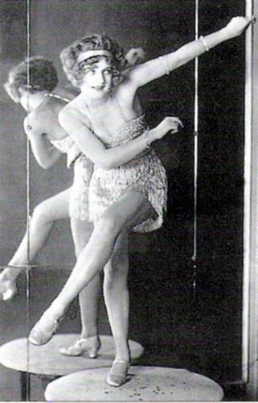
The Jazz Age
Watch the film about The Jazz Age and note down all the key facts about this time in American history.

Slide 4
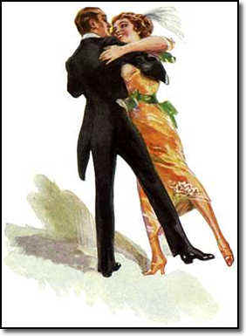
Historical Background and Context of ‘The Great Gatsby’
F. Scott Fitzgerald was writing during the 1920s and the final draft of ‘The Great Gatsby’ was completed in 1925.
Post-war America was a place of huge transformations where The American Dream inspired many but disillusioned others as it was an era of unprecedented prosperity and material excess.
The country saw many changes and developments and some of these can be categorised under the following headings that link to ‘The Great Gatsby’: The Jazz Age / Advertising and the Mass Market / Conspicuous Consumption / Prohibition and Organised Crime / Mass Culture / Photographs.

Slide 5
The Narrator (AO2 & AO3)
Silent debate followed by an open gallery.
It is the narrator who puts the ‘great’ in Gatsby.
What are the advantages and disadvantages of having a narrator who is also one of the main characters?
The novel opens with the narrator and an aphorism: ‘Whenever you feel like criticising anyone, just remember that all the people in the world haven’t had the advantages that you have.’ One consequence of this for Nick Carraway is that he is ‘inclined to reserve all judgements’. What is the moral message behind this statement, and what other consequences might there be?
He then qualifies that statement by defining advantages as ‘fundamental decencies’ thereby setting up a reference point for the reader. What is this and what else is the reader invited to do?
He is also telling the reader something about his account of events and the manner of telling. What is it?

Slide 6
Who is Nick Carraway? (AO2)
Quote explosions
“My family have been well-to-do people in this Middle Western city for three generations....we have a tradition that we’re descended from the Dukes of Buccleuch...” (p8)
“ I graduated from New Haven in 1915, just a quarter of a century after my father...I participated in that delayed Teutonic migration known as the Great War.” (p9)
“Father agreed to finance me for a year, and after various delays I came East. Permanently, I thought, in the spring of twenty-two.” (p9)
“...promising to unfold the shining secrets that only Midas and Morgan and Maecenas knew.” (p10)
“I love to see you at table, Nick. You remind me of a – of a rose, an absolute rose.” (p19)
“I was conscious of wanting to look squarely at everyone, and yet to avoid all eyes.” (p20-21)

Slide 7
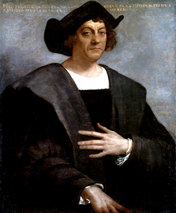
The Eggs (AO4)
West Vs East
New money Old money
“...the less fashionable of the two...”
Aligns itself with American ideals.
Embodies the notion of the dream
New money lies in WE
Contains original spirit of The Land of Opportunity
“...the white palaces of fashionable East Egg glittered along the water”
Embodies old world ideals of patronage, class and heredity values.
They are the antithesis of ‘The Dream’
Full of emotionally stunted, aimless, shallow ideals.
As careless and socially indifferent as West but live with more style.

Slide 8
The Role of Dialogue (AO2) - Discuss
Read the script of pages 14-17
Why has Fitzgerald used dialogue rather than Nick’s narration to present the interaction at the dinner party?
It is more direct.
To prevent Nick’s voice becoming too monotonous and narrow in interest.
Fitzgerald allows us to hear the voices of the other characters.
Dialogue allows the reader to form their own opinion and draw their own conclusions which may differ from the narrator’s.
A book written solely through the musings of one person becomes self-analytical and therefore slow-paced and heavy reading.

Slide 9
The Buchanans
Pair - square
“They had spent a year in France for no particular reason, and then drifted
here and there unrestfully wherever people played polo and were rich
together.” (p11)
The Buchanans are introduced from p11.
Nick sums Tom up as having ‘a cruel body’ (p12). Find further quotations in order to expand on this description.
Nick knows Tom from his days at Yale but how would you describe his behaviour in Tom’s company. Refer to the text.
Tom’s racist rant further informs our understanding of his character and the time. Expand on this.
Glass half empty or half full. Which would describe Tom’s view of the world? Why?

Slide 10
Daisy
Her voice: “...a singing compulsion, a whispered ‘Listen’, a promise that she had done gay, exciting things just a while since and that there were gay, exciting things hovering in the next hour.” (p14-15) Does Nick find Daisy attractive?
“They were both in white, and their dresses were rippling and fluttering...” (p13) What are the connotations of wearing white?
“What do people plan?” (p17) How does Daisy spend her days?
“I saw that turbulent emotions possessed her.” (p21)
“Well, I’ve had a very bad time, Nick, and I’m pretty cynical about everything.” What is causing Daisy such misery?
“- that’s the best thing a girl can be in this world, a beautiful little fool.” (p22) Does this description suit Daisy?
Consider Nick’s response to Daisy’s outburst on p22. How does this influence the reader’s impression of Daisy in chapter one?
“..surprising me by opening up in a flower-like way.” Does the name ‘Daisy’ suit the character?

Slide 11
Gatsby
What does Nick admire about Gatsby? How
does this reinforce a point already made by the narrator? Use quotations to assist your explanation (p7-8).
What does Gatsby’s home suggest about the character? Consider location and appearance in your answer. Compare this description with that of the Buchanan’s house on p12.
How does Nick present Gatsby to the reader on his first sighting of his neighbour?
What is the significance of the green light (which will be mentioned again?) Consider the symbolic quality of green.

Slide 12
Symbolism (A03)
It could represent money – green is the colour of money in America and this could be a symbol of “the dream” and achieving wealth.
Alternatively, green can represent jealously and envy and this could indeed be applied to Gatsby’s desire to be part of East Egg society and to be just like them, while knowing that he will never be good enough.
The light could also represent Daisy, like a beacon calling him forward and putting him under her spell.
By placing this episode at the end of the chapter, Fitzgerald effectively foreshadows and delays Gatsby's introduction to the novel, and his obsession with Daisy Buchanan – indeed, by painting a comprehensively damning portrait of her character in this chapter, he questions the very wisdom of this love.

Slide 13
Home Learning
Read Chapter 2 and 3 – next lesson
Write a brief description of the 3 different parties we have seen so far:
dinner party at Buchanans (chapter 1)
party in Tom's flat in NYC (chapter 2)
party at Gatsby's (chapter 3)
Why might Fitzgerald have chosen to structure the first 3 chapters like this? How do the succession of parties shape the reader's understanding of the novel?

