Slide 1
Exploring the Presentation of the Creature
LO: To examine how the presentation of the creature develops throughout the narrative
LO: To debate the role/purpose of the creature in the novel as whole and how it relate to the gothic

Slide 2
Key Words
Villainous
Malign
Isolation
Imprisonment and confinement
Human and inhuman

Slide 3
Connector:
Look back at the quotations from chapter 5.
Make a list of as many ways to describe the creation as you can, based on inference of the language used by Frankenstein.
“Adam of your labours”
“Fiend” “thing”
“Creature” “being”
“Demon” “ogre
“Wretch” “Devil”
“Thing”
Extension: How far do your descriptions match up to the names the creature is labelled with in the text?

Slide 4
Narrative Structure
Multiple narratives are a typical convention of gothic fiction
Remember, the narrative perspective is integral to our understanding of the way Shelley wishes us to view her characters and her underlying message.
Look at the two images below.
How might they explain the construction of the narrative?
How might these shapes effect the way we view the monster in Chapter 5?
Who is the ‘real’ monster?

Slide 5
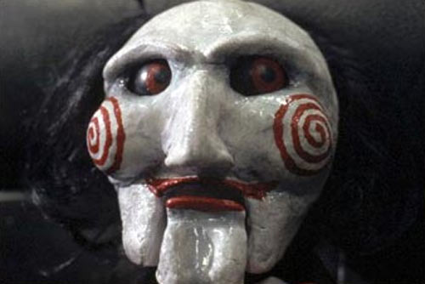
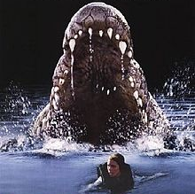
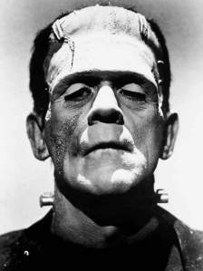
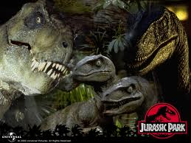
AO3: Variety of interpretations…
Why involve monstrous elements in fiction and media?

Slide 6
Why include “monsters” in fictional works?
“Monsters appear in literary and political writings, from the 1800s until today, to signal both a terrible threat to established orders and a call to arms that demands the unification and protection of authorised values. Symptoms of anxiety and instability, monsters frequently emerge in revolutionary periods as dark and ominous doubles restlessly announcing an explosion of apocalyptic energy.”
Therefore the ‘monster’ in the text is more of a symbol of social anxieties Shelley may have had…?

Slide 7
In pairs complete this sentence:
To be “monstrous” is to be...
Violent
Revengeful
Animalistic
Inhumane; completely removed from empathy.
Lacking in passion for the well being of others
Isolated from society

Slide 8
Outsiders, isolation, imprisonment
Another typical gothic convention – The figure of the Outsider
‘Outsiders’ are an archetypal gothic figure, What do they represent?
What causes the monster to be an outsider?
The unknown
The unacceptable
The damned
The fearsome
The horrific
Disempowerment
Loss of identity
Loss of cohesion
Loss of relationships
Destruction of familial ties
Destruction of societal ties

Slide 9
The Monster’s Narrative
Volume 2 Chapter 3 – Volume 2 Chapter 8
Scan through Volume 2 Chapter 3 (or chapter 11)
Find 3 – 5 quotations to show:
Isolation
Abandonment
Maltreatment
Shelley creating pathos for the monster

Slide 10
Broken Pieces
The monster fulfils the role of archetypal gothic female – powerless and weak
The monster

Slide 11
Model Essay
How well does the model essay present their argument?

Slide 12
Is the monster a victim or a villain?
Remember ‘Treesoning’

