Slide 1
Look carefully over your essays.
Think-how could you target be met.
Write one piece of advice for the class about how to do well.

Slide 2
Is the purpose of art? To instruct or delight?
discuss

Slide 3
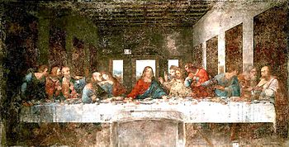

Slide 4
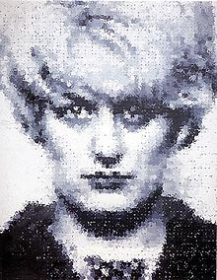

Slide 8
My Last Duchess - mindmap
My Last Duchess.

Slide 9
Objective:
-to work to understand Fra Lippo Lippi, drawing ideas more independently from: your own reading of texts, peer discussion, and internet based findings.

Slide 10
Fra Lippo Lippi http://www.poetryfoundation.org/poem/173011 Without me providing it...
You will research and present on any of the following:
Timing and sequencing
Scenes and places
Characters
Voices
Points of view
Destination
www.poetryfoundation.org is a fabulous place to start researching!

Slide 11
Presenting your ideas

Slide 12
“Fra Lippo Lippi” takes place during the Renaissance in Florence, at the height of its wealth and power, Browning sets the poem in a back alley beside a brothel, not in a palace or a garden. Browning was instrumental in helping readers and writers understand that poetry as an art form could handle subjects both lofty, such as religious splendor and idealized passion, and base, such as murder, hatred, and madness, subjects that had previously only been explored in novels.

Slide 13
Form
“Fra Lippo Lippi” takes the form of blank verse—unrhymed lines, most of which fall roughly into iambic pentameter. As in much of his other poetry, Browning seeks to capture colloquial speech, and in many parts of the poem he succeeds admirably: Lippo includes outbursts, bits of songs, and other odds and ends in his rant. In his way Browning brilliantly captures the feel of a late-night, drunken encounter.

Slide 14
Fra Lippo Lippi

Slide 15
“Browning’s characters are usually crafty, intelligent, argumentative, and capable of lying.”
Agree?
Discuss, be ready to provide examples from the poems studied so far!

Slide 16
Psychological Portraits
Dramatic monologues feature a solitary speaker addressing at least one silent. Browning’s characters are usually crafty, intelligent, argumentative, and capable of lying. Indeed, they often leave out more of a story than they actually tell. In order to fully understand the speakers and their psychologies, readers must carefully pay attention to word choice, to logical progression, and to the use of figures of speech, including any metaphors or analogies. For instance, the speaker of “My Last Duchess” essentially confesses to murdering his wife, even though he never expresses his guilt outright.

Slide 17
Key Extracts

Slide 18
Section A – past paper on Browning
Write about the way Browning narrates his poem in ‘Fra Lippo Lippi’.
How far do you agree that the characters in Browning’s poems display a disturbing lack
of morality?
Plan an answer to one...are you incorporating your targets from past essays?

Slide 19
Section B – example for future reference
Many narratives have one or more significant moments of crisis.
Write about the significance of crises in the
work of the three writers you have
studied. (42 marks)
OR
How do writers use repetition to create meanings in their texts?
In your answer, refer to the work of the three writers you have studied.

Slide 20
Homelearning
Annotate the remainder of the poem independently
Use research skills
-

