Slide 1
Gothic Literature
LO: To explore what the gothic genre is and how it is depicted through art, poetry and narrative.
Big Picture:
‘The Raven’
Secondary reading for the convention of the gothic
Gothic through art
Gothic through narrative
Writing your own gothic piece

Slide 2
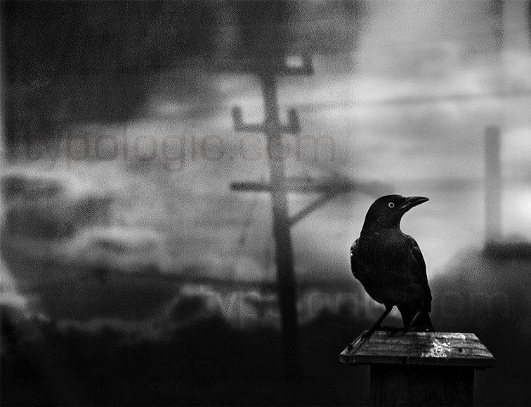
Connector
Fact: A raven is widely considered a creature of ill omen. It is feared for its apparent ability to foresee death.
Listen to Edgar Allen Poe’s ‘The Raven’
How do you feel when listening?
What kind of atmosphere is created?
Based on what you have listened to what do you think the gothic is?
http://www.youtube.com/watch?v=UNjrf1RKIvM&feature=related

Slide 3
The Gothic
Pair work
Read the selections from Eve Kosofsky Sedgwick, ‘The Coherence of Gothic Conventions’ and ‘Gothic’ by Fred Botting.
Write at least a 6 bullet point list in your own words explaining what the gothic is.

Slide 4
Characteristics of the Gothic
Read the worksheet given to you. Having read this, can you add anything else to your notes?

Slide 5
Key words relating to the Gothic
Religion
Supernatural
The sublime (awe/ wonderment)
Pathetic fallacy
Shape shifting
Anthropomorphism (another term for personification)
Science
Reason
Superstition
Hysteria (madness)
Foreign
Be prepared to discuss what you have learnt about the gothic afterwards.
Using your marker pen write key words/ phrases to match the pictures around the room.
e.g. Struggle between good/evil

Slide 6
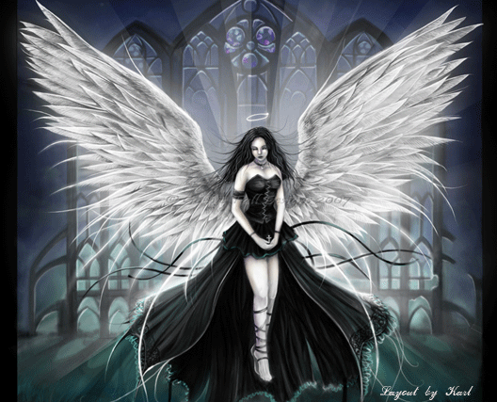
Reading the gothic – extracts
Read the following extracts:
Mary Shelley, ‘Frankenstein’
Emily Bronte, ‘Wuthering Heights’
Bram Stoker, ‘Dracula’
Susan Hill, ‘The Woman in Black’
Pair work
In each piece, highlight the gothic conventions and make notes (where possible) regarding the following:
the portrayal of women
knowledge
Light/darkness
Setting
wild vs civilised
Consider why each are conveyed in the way they are. What are the writers’ intentions?

Slide 7
Be Creative!
Write your own gothic version of ‘The Raven’ or your own opening to a gothic novel.
Think about your choice of vocabulary, weather, themes and other conventions of the gothic discussed today!

Slide 8
Review
Catch the ball and tell me what you think the gothic is. Be prepared for me to challenge you!

