Slide 1
Connector
Using your understanding from last lesson, we will now hold a debate.
Which critical perspective regarding Heathcliff is the most accurate?
Use your tokens
Respond to each other
Build and defend your perspective
Use wide-ranging evidence from the text

Slide 2
Model Essay
Read through and consider how the essay has been marked
Positive annotations highlight good areas
Use of words from the mark scheme
Use of assessment objectives
Clear and detailed WWW/Target

Slide 3
Self-Assessment
Read through your essay. Double ticks show areas of good work. Reflect on your work and add your own annotations.
AO1:
written expression
appropriate vocabulary
fluent style
Clear and logical argument
Focus on task and text
AO2:
Analysis of form
Analysis of structure
Analysis of language
How do these aspects shape meaning in the text?
AO3:
Different interpretations
Different perspectives
Critical perspectives
Connections to the gothic genre made
AO4:
Specific links to text and task
Contexts of reception
Contexts of production
Contexts of the gothic genre
Band 1 = limited
Band 2 = Some awareness
Band 3 = Some consideration
Band 4 = Detailed consideration
Band 5 = Exploration
Band 6 = Evaluation

Slide 4
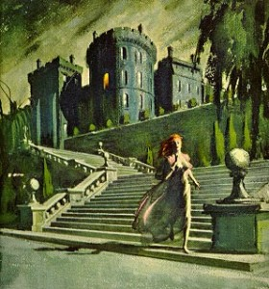
Gothic Women in Wuthering Heights
David Punter The Literature of Terror:
“Gothic fiction was peopled with stock characters, who discoursed in predictable ways: the shy, nervous, retiring heroine, who was nevertheless usually possessed of a remarkable ability to survive hideously dangerous situations”

Slide 5
Character Mapping
In your groups, complete the Character Map for Isabella and Catherine Earnshaw.
Use the booklets to help you
Use your own text
Use the quotations and critical statements
Challenge:
Complete the venn diagram, deciding how your character challenges and conforms to Punter’s idea of a typical Gothic female.

Slide 6
Present
In your groups present your ideas about your character and how they fit in t the gothic archetype.

Slide 7
Homelearning
Read the two articles about women in Wuthering Heights
Complete the blog topic online.

