Slide 1
Heathcliff: A Gothic Hero?
LO: To explore Bronte’s characterisation in Volume One

Slide 2
Heathcliff

Slide 3
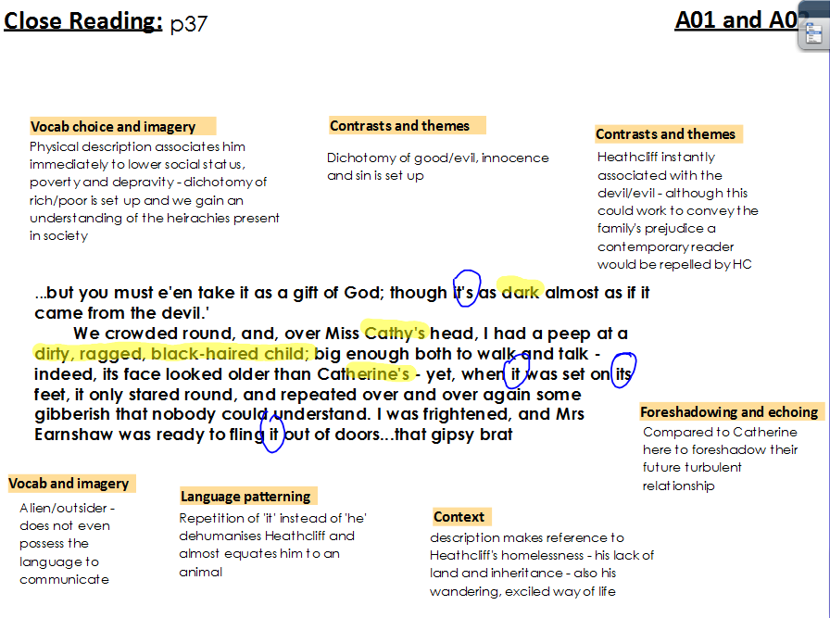

Slide 4
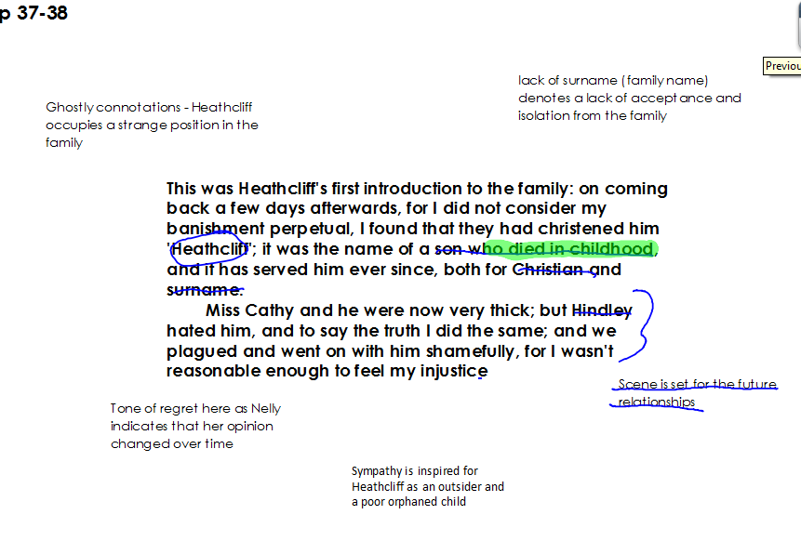

Slide 7
Linking to the Gothic
One kind of barrier or threshold that Brontë examines in Wuthering Heights is the barrier between classes. If we take liminality to mean: the unfixed position between any two oppositional terms; the experience of being on a threshold or a boundary; marginal we can see that Heathcliff is a liminal character in many ways. He is firstly marginal in society, being labelled as a ‘gypsy brat’ when he first arrives. As gypsies are on the outskirts of society, this makes him an outsider, as Nelly says: Who knows, but your father was Emperor of China and your mother an Indian queen. This gives him an air of mystery, often associated with Gothic protagonists. In addition, his name is the name of an outsider as it is not a real family name:
Heathcliff; it was the name of a son who died in childhood.
He is thus named after the dead which also gives him, in a way, a marginal position between the living and the dead. He has no surname, only Heathcliff: ‘it has served him ever since, both for Christian and surname’. Heathcliff is also on the borderline between a supernatural creature and a man. Hindley refers to him as an ‘imp of Satan’ and when he first arrives, Mr Earnshaw describes him as ‘as dark almost as if it came from the devil.’ The story of Wuthering Heights could partly be seen as the story of the attack of this marginal character on the society that keeps him on the edge; he sees economic power as the route to breaking down the barriers imposed on him and in a way he is right, but he doesn’t see that wreaking his terrible revenge will destroy him and his bloodline. Brontë seems to be using Heathcliff’s liminality to point up the fact that the higher echelons of Victorian society are impenetrable to outsiders, even those with money.

Slide 8
Review: Broken Pieces

