Slide 1
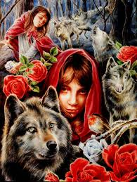
In the Company of Wolves and Wolf Alice
LO: To reflect on our mock exams and through analysing model essays improve our written responses.
Today you will focus on the Assessment Objective appropriate for you based on your targets.

Slide 2
Mock Feedback
Read through my advice/ marks/ comments/ targets and WWW.
Fill in your trackers clearly and carefully.
Do you notice any patterns or consistent targets you need to work on? How can you achieve these?

Slide 3
Model Essay
Read through the model essay together.
How could you have planned more effectively with the time given?
Use 10 minutes now to re-do your plan using the model essay and all your resources making it as detailed as you can.
This is an effective revision strategy
Extension Homelearning:
Re-do your mock exam taking into consideration your targets and comments. I will mark this and give you constructive feedback. This can be completed at home or in the study club:
Mondays 4-5pm 103

Slide 4
Group Work
You will now be split into two groups.
Half will study ‘In the Company of Wolves’ and half ‘Wolf Alice’
Use the question prompts. Choose two questions which you will answer fully and in detail.
On your sugar paper you need to create analytical paragraphs.
You need to plan your answers.
You need to work together.
You need to extend discussion skills.
You need to present your ideas at the end.

Slide 5
Presentations
In your groups you now need to share your responses to your chosen tasks.
You are teaching your peers so ensure you are clear and detailed!

Slide 6
Homelearning
Read Frankenstein
Begin making annotations and highlighting your text.

