Slide 1
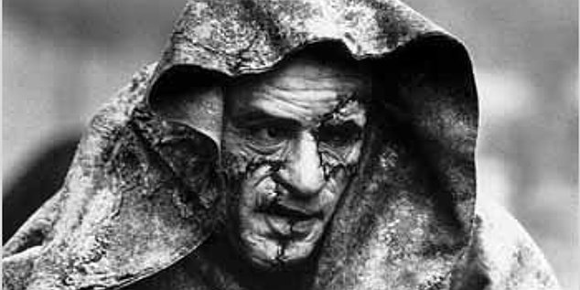
L.O – To begin to understand this unit and the A2 year, how it will be assessed, and what the Gothic is...

Slide 2
Before research, what do you know about Gothic fiction?
How could the Gothic be symbolised in the images below?

Slide 3
Your Gothic exam texts:
‘Frankenstein’ – Mary Shelley
‘Macbeth’ – William Shakespeare
‘The Bloody Chamber’ – Angela Carter
YOU NEED TO READ, RE-READ AND KNOW THESE TEXTS VERY WELL!

Slide 4
Let’s break into groups to discuss some key questions related to the Gothic:
Do you see women as more predator or victim?
FEEDBACK
What is the difference between humans and monsters? What are the boundaries?
FEEDBACK
In your view, what is the role of Hell?
FEEDBACK
FEEDBACK
FEEDBACK
What is the problem with excessive violence in society?

Slide 5
Write your personal response.
The violence in this clip is so excessive that it ceases to have any effect on the audience. To what extent is this accurate?
http://www.youtube.com/watch?v=yMwmqp3GLMc
This is an A2 exam question from January 2011! The questions aren’t too daunting, but you must know the texts inside out...

Slide 6
For this example exam question, here are the sorts of areas you would be expected to write about!
Feeling scared or reassured?

Slide 7
Mark scheme for this exam – notice any similarities or differences the AS exam?
NOTE DOWN WHAT AOs WILL BE ASSESSED, AND HOW YOU CAN DO WELL!

Slide 8
This unit questions students on the centrality of religion to the Gothic genre, the extent to which women are predators or victims, and the contrast of “nightmarish terrors” and the “civilised mind”. It also raises the question of the “macabre” and the “supernatural”, and students are asked to consider the boundaries between humans and monsters, the role of Satan and Hell, and the problem of excessive violence. These issues might be described as “commonly accepted principles” of the Gothic.
Elements of the Gothic
Choose red areas to research in relation to the Gothic genre, as well as researching more generally!

Slide 9
Presenting what you’ve learnt
You will each have 30 seconds to 1 minute to share your research afterwards.
(If you opt to pair up your presenting time should last double, etc!)

Slide 10
Review 1
“She herself is a haunted house. She does not possess herself; her ancestors sometimes come and peer out of the windows of her eyes and that is very frightening. ” - From "The Lady of the Haunted House” ― Angela Carter, The Bloody Chamber and Other Stories.
Why could this be considered to fit the Gothic genre?

Slide 11
Review 2
“First Witch: When shall we three meet again In thunder, lightning, or in rain? Second Witch: When the hurlyburly's done, When the battle's lost and won." - William Shakespeare, Macbeth, 1.1
Why could this be considered to fit the Gothic genre?

Slide 12
Review 3
“Life and death appeared to me ideal bounds, which I should first break through, and pour a torrent of light into our dark world."
-Victor’s narration, ‘Frankenstein’ Chapter. 4 by Mary Shelley.
Why could this be considered to fit the Gothic genre?

