Slide 1
How can you link this image to Wuthering Heights?
Notes:
Resources needed: pages 9, 11, 13 of English and Media Centre Booklet

Slide 2
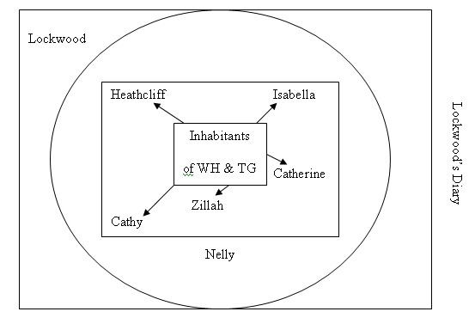
Frame Narrative
A frame narrative is employed in WH. The story is told by many characters.
The outer narrator (or surface narrator is Lockwood.
Lockwood’s narrative contains Nelly Dean’s tale.
Nelly’s narrative contains many other character’s narrations and versions of events.

Slide 3
Wuthering Heights and the Gothic
LO: To explore and analyse the narrative structure and link closely to the gothic genre

Slide 4
Connector:
Complete the family tree, showing your understanding of the characters roles and positions in the novel.
Add the below names into the family tree structure:
Hindley
Catherine 1
Catherine 2
Heathcliff
Edgar
Hareton
3) Now place the following characters in your map. They may be in several places and linked to several characters:
Nelly
Lockwood
Joseph
Zillah
4) Add any other important relationships to your map such as;
Sworn enemies
Characters seeking revenge
Bound by duty of service
Haunted by ghosts of others
2) Now link the characters through their more unconventional bonds by linking some of the following:
Foster child and guardian
Adoptive parents after death
Lovers

Slide 5
Narrative in Wuthering Heights
Key Question: What is the role of a narrator in a text?
What is their purpose?
How does the reader rely upon them?
How does the author use them?
What kind of narrators are present in WH?
Think, pair, share

Slide 6
Lockwood’s Narrative
Read and annotate the three extracts using the following ideas below.
Key Question: What kind of narrator is Lockwood?
A narrator can:
Belong to the same reality as the characters (diegetic) | Stand outside the story (extradiegetic)
Participate in the story | Tell the story without any involvement
Be perceptive | Misread events
Play a role in the story and the reader is aware of him as a character | Be ‘invisible’ and the reader is unaware of any narrator or narrative voice
Be reliable and the reader believes everything they say | Be unreliable through deliberate deceit or unperceptive observations

Slide 7
Nelly and Lockwood
Now discuss in your pairs the extracts from Nelly and Lockwood. What do you notice about the following categories:
Vocabulary
Sentence structure
Punctuation
Tone
The overall effect on narrative voice

Slide 8
Duel Narration
Now divide the statements;
Nelly
Lockwood
Both
Nelly
Lockwood

Slide 9
Context – AO4
Reasons for early criticism:
Victorian readers believed it was the novelists job to make clear his position and their duty to make their meaning plain.
Victorian novels often had a didactic purpose narrated by a morally strong voice – Bronte’s embedded narrative confused this and multiple voices did not offer a clear message to the reader.
The duel and frame narrative destabilised and challenged this.
Read the article ‘Challenging Orthadoxy’
Key Question: How can the narrative structure be linked to the Gothic?

Slide 10
Review
Answer the question on your Narrative Structure sheet using key examples from extracts studied today.

