Slide 1
Connector
List the following statements 1-5 with 1 being the statement that you most agree with and 5 being the statement that you least agree with.
Browning’s poetry presents women in a negative way
Browning has a corrupt mind
Browning’s poetry presents men in a negative way
Browning’s poetry is based around moral issues
Browning is critical of people with power and status
BE PREPARED TO DISCUSS YOUR CHOICES!

Slide 2
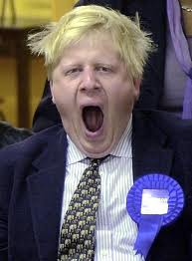
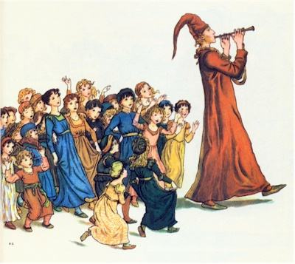
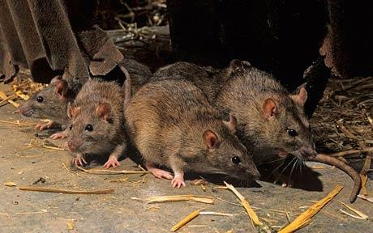
The Pied Piper of Hamelin

Slide 3
The Pied Piper of Hamelin
Poem adapted from a sixteenth century legend.
http://www.youtube.com/watch?v=GPEMn8aVNvk
PREDICTIONS:
From reading other Browning poem’s what do you predict about his adaptation of this legend?
How do you think he portrays the town’s people and the Piper?

Slide 4
ADD IN THE ROMAN NUMERALS TO EACH STANZA!
i = 1
ii=2
iii=3
iv=4
v=5
vi=6
Etc!
ix=9
x=10
xi=11
Etc!

Slide 5
The Pied Piper of Hamelin
Past exam question: Write about the ways Browning tells the story in Sections VII, VIII, IX, X and XI of ‘The Pied Piper of Hamelin’.
Pairs to annotate each of the above sections; VII, VIII, IX and X.
Feedback: SHARE YOUR IDEAS AND READ YOUR SECTION
FORM... IS IT A MONOLOGUE?
STRUCTURE...SYLLABIC PATTERNS?RHYME SCHEME? LINE LENGTH?
LANGUAGE...

Slide 6
Close reading of Browning’s poem
In addition to analysing the story, your annotations should focus on:
The roles of power and status
The way that characters are presented
The way that Browning adapts the legend
The moral of the tale
Links with other Browning poems

Slide 7
Section XI
Speech- highlights the actual ignorance of the Mayor; no bias from the narrator.
Rhetorical questioning is frequent- Power play not waiting for a response
"How?" cried the Mayor, "d'ye think I'll brook Being worse treated than a Cook? Insulted by a lazy ribald With idle pipe and vesture piebald? You threaten us, fellow? Do your worst, Blow your pipe there till you burst!"
Rhyming couplets- Enhance the pace of the poem/ highlight the Mayor’s intensity
Dramatic Irony- prior knowledge of the legend allows the reader to know that the Mayor’s words are about to be punished.

Slide 8
Essay Planning
Use the essay planning sheet provided... You may find this way useful for your exam!

Slide 9
review
Has Browning changed your thoughts, having read this last poem?
Browning’s poetry presents women in a negative way
Browning has a corrupt mind
Browning’s poetry presents men in a negative way
Browning’s poetry is based around moral issues
Browning is critical of people with power and status

Slide 10
Extension- review
Can you make statements about Browning’s poetry...

