Slide 1
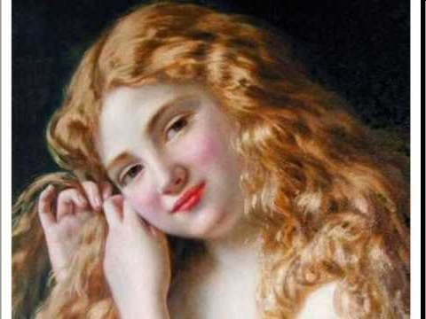
Porphyria’s Lover
By Robert Browning
AO3: To offer a variety of interpretations and readings.
L.O: To analyse and evaluate a variety of interpretations of the poem.

Slide 2
Connector: Image Analysis
Move around the 3 different images and annotate with key ideas we know about Browning so far. Use the questions to help you.
Key Ideas:
Position of women
Exploration of human psyche
Exploration of base subjects
Controversy
Macabre
Power
Notes:
Key Images Worksheet

Slide 3
Porphyria’s Lover
As we listen:
Check literal understanding – what is actually happening?
Underline key quotes – how is characterisation established?
Key Themes:
Power and passivity
Objectification of women
Social class
Immorality
The ‘Fallen Woman’
http://www.youtube.com/watch?v=fE6PjB1kn4w
Notes:
Copy of the poem needed.

Slide 4
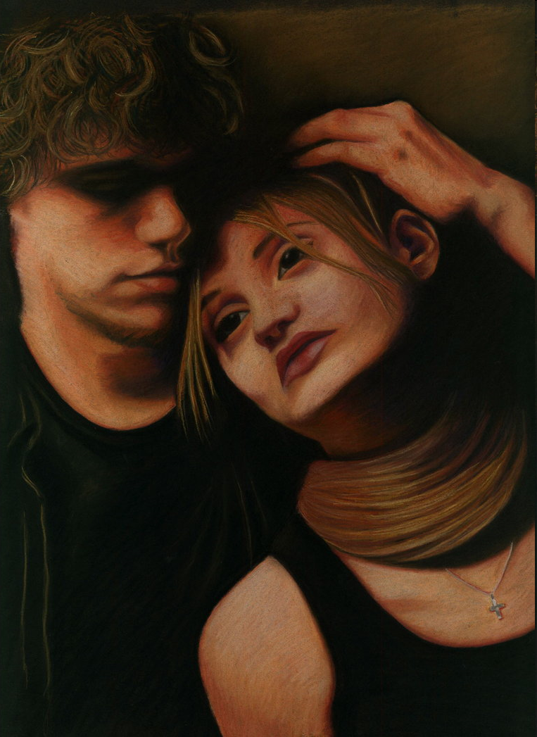
Discuss: Literal Meaning
What is actually happening in the poem….
Input:
The Fallen Woman – what does this mean and how is it symbolised in the poem?
Notes:
Fallen Woman Worksheet needed.

Slide 5
Critical Analysis
You will now be given some analysis to help inform your reading of the poem and address A03.
Task One: Read through and annotate as much as possible:
Key themes
Poetic techniques
Interpretations
Notes:
Reading of the Poem 1 and 2 needed.

Slide 6
Analysis
20 minutes
The rain set early in to-night, The sullen wind was soon awake, It tore the elm-tops down for spite, And did its worst to vex the lake: I listened with heart fit to break. When glided in Porphyria; straight She shut the cold out and the storm, And kneeled and made the cheerless grate Blaze up, and all the cottage warm;

Slide 7
Which done, she rose, and from her form 10 Withdrew the dripping cloak and shawl, And laid her soiled gloves by, untied Her hat and let the damp hair fall, And, last, she sat down by my side And called me. When no voice replied, She put my arm about her waist, And made her smooth white shoulder bare, And all her yellow hair displaced, And, stooping, made my cheek lie there,

Slide 8
And spread, o'er all, her yellow hair, 20 Murmuring how she loved me--she Too weak, for all her heart's endeavour, To set its struggling passion free From pride, and vainer ties dissever, And give herself to me for ever. But passion sometimes would prevail, Nor could to-night's gay feast restrain A sudden thought of one so pale For love of her, and all in vain: So, she was come through wind and rain.

Slide 9
Be sure I looked up at her eyes Happy and proud; at last I knew Porphyria worshipped me; surprise Made my heart swell, and still it grew While I debated what to do. That moment she was mine, mine, fair, Perfectly pure and good: I found A thing to do, and all her hair In one long yellow string I wound Three times her little throat around,

Slide 10
And strangled her. No pain felt she; I am quite sure she felt no pain. As a shut bud that holds a bee, I warily oped her lids: again Laughed the blue eyes without a stain. And I untightened next the tress About her neck; her cheek once more Blushed bright beneath my burning kiss: I propped her head up as before,

Slide 11
Only, this time my shoulder bore 50 Her head, which droops upon it still: The smiling rosy little head, So glad it has its utmost will, That all it scorned at once is fled, And I, its love, am gained instead! Porphyria's love: she guessed not how Her darling one wish would be heard. And thus we sit together now, And all night long we have not stirred, And yet God has not said a word!

Slide 12
Extend and Challenge: AO3
Task Two: Read through the critical analysis offering a different interpretation.
Can you add anything to your interpretations?
Annotate and then we will discuss

Slide 13
How far do you agree that the characters in Browning’s poems display a disturbing lack of morality so they are impossible to sympathise with?
This is your homelearning question.
Base your answer on both MLD and PL.
This is a section A even numbered questions
What AOs do you need to include?
AO1, AO3, AO4

