Slide 1
Summarising Chapter 2 Think, pair, share.
Write a quick chapter summary of what happens. You do not have to include quotes. Bullet point the important aspects.
What events/facts/observations, which occur in this chapter, do you think we need to study during the course of this lesson? Why?
Can you put the characters in the order in which the reader meets them in chap 1 and 2? George Wilson, Jordan Baker, Nick Carraway, Jay Gatsby, Tom Buchanan, Daisy Buchanan, Myrtle Wilson
Why do you think Fitzgerald chooses to introduce them in this order? (AO2)

Slide 2
Presentations
Who is Nick Carraway?
The Eggs
The role of dialogue
The Buchanans

Slide 3
Daisy and Gatsby
One group will focus on the character of Daisy.
One group will focus on the character of Gatsby
You will then pair up (Gatsby with Daisy) and teach one another.
Daisy
Gatsby

Slide 4
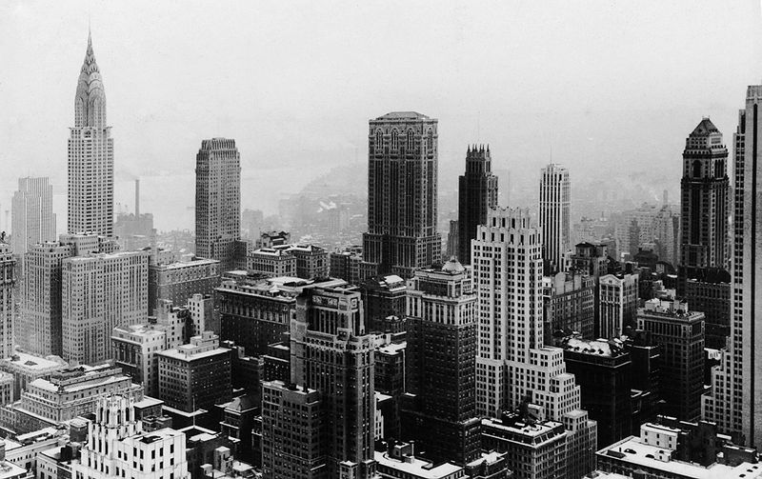
Chapter Summary
Introduced to a third setting – The Valley of Ashes. This shows a darker side to the American Dream and demonstrates what happens if you work hard but don’t achieve what you want.
Meet George and Myrtle Wilson, the only impoverished characters in the novel and they live in the Valley of Ashes.
Find out that Tom and Myrtle are having an affair and Myrtle has aspirations to leave the ash pit. She sees Tom as her ticket out and does not accept that there is no chance of a permanent relationship between the two.
Shown the contrasts between Daisy and Myrtle.
Move to another setting – Manhattan, New York. Tom, Nick, Myrtle and other people through a small party and we see a darker side to Tom’s character as he punches Myrtle when she insults Daisy.
The theme of artifice (pretence) and reality is explored in this chapter.

Slide 5
Explode the extract. What do you learn about the Valley of Ashes?
About half-way between West Egg and New York the motor road hastily joins the railroad and runs beside it for a quarter of a mile, so as to shrink away from a certain desolate area of land. This is a valley of ashes--a fantastic farm where ashes grow like wheat into ridges and hills and grotesque gardens; where ashes take the forms of houses and chimneys and rising smoke and, finally, with a transcendent effort, of ash-grey men, who move dimly and already crumbling through the powdery air. Occasionally a line of grey cars crawls along an invisible track, gives out a ghastly creak, and comes to rest, and immediately the ash-grey men swarm up with leaden spades and stir up an impenetrable cloud which screens their obscure operations from your sight.
AO4:
‘Yea, though I walk through the valley of the shadow of death, I will fear no evil: for thou art with me; thy rod and thy staff they comfort me.’ (Psalm 23.4 King James Bible)
AO3 and AO4:
“What are the roots that clutch, what branches grow
Out of this stony rubbish? Son of man,
You cannot say, or guess, for you know only
A heap of broken images, where the sun beats,
And the dead tree gives no shelter, the cricket no relief,
And the dry stone no sound of water.”
Extract from The Wasteland by T.S. Eliot
After reading these two quotations, consider and discuss their relevance to the opening paragraph of chapter 2.
Fitzgerald does not use geography and landscape simply as background. Consider the significance of the location of the valley of ashes.

Slide 6
Main Images and Ideas (AO2,AO3,AO4)
Analyse the section(s) given to you.
You must explain the importance of your section(s) in regards to the setting and what you think this symbolises in the novel.
About half-way between West Egg and New York the motor road hastily joins the railroad and runs beside it for a quarter of a mile, so as to shrink away from a certain desolate area of land. This is a valley of ashes--a fantastic farm where ashes grow like wheat into ridges and hills and grotesque gardens; where ashes take the forms of houses and chimneys and rising smoke and, finally, with a transcendent effort, of ash-grey men, who move dimly and already crumbling through the powdery air. Occasionally a line of grey cars crawls along an invisible track, gives out a ghastly creak, and comes to rest, and immediately the ash-grey men swarm up with leaden spades and stir up an impenetrable cloud which screens their obscure operations from your sight.
ASH – Think about:
The connotation of this word
What this tells you about the setting
The type of people who live there
The lives they lead
LACK OF COLOUR AND DEFINITION – Think about:
What this tells you about society and how they are viewed by others
How this relates to the American Dream
The connotations of the colour grey

Slide 7
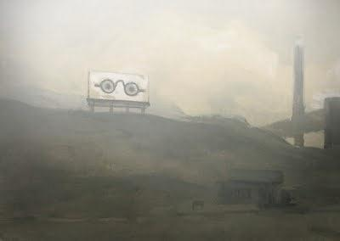
The Valley of Ashes
Ash: has a traditionally negative association with decay/waste/dirt – think of crematoriums, ‘ashes to ashes dust to dust’, cigarette trays. But it has positive connotations too – the phoenix rising from the ashes for example.
This can perhaps symbolise the redemptive nature of humanity – the ability of men to pull through circumstances of great hardship and suffering.
The ash-grey men at work in this place symbolise the downtrodden working class chained forever to industry and monotony.
They move ‘dimly and already crumbling through the powdery air”. Living out a mere half-life, a million miles from the splendour and indulgence of the Buchanans’ environment.

Slide 8
The Valley of Ashes – Lack of Colour and Definition in the Landscape
A line of grey cards crawls along an invisible track…
immediately the ash-grey men swarm up with leaden spades
and stir up an impenetrable (hidden) cloud, which screens
their obscure operations from your sight.
What is suggested about this section of society?
This perhaps represents the idea that this section of society is deliberately hidden from view (notice how the train curls away from the Valley, as if it ‘shrinks away’ from having to confront it).
In modern industrial society, the polarisation between the haves and have-nots, between the slaves and the masters, grows ever stronger.
By repeating images of greyness, obscuring cloud and blindness, Fitzgerald emphasises the tendency of the privileged to casually ‘overlook’ the reality of hellholes such as these.

Slide 9
The interior was unprosperous and bare; the only car visible was the dust-covered wreck of a Ford which crouched in a dim corner. It had occurred to me that this shadow of a garage must be a blind, and that sumptuous and romantic apartments were concealed overhead, when the proprietor himself appeared in the door of an office, wiping his hands on a piece of waste. He was a blond, spiritless man, anaemic, and faintly handsome. When he saw us a damp gleam of hope sprang into his light blue eyes. "Hello, Wilson, old man," said Tom, slapping him jovially on the shoulder. "How's business?" "I can't complain," answered Wilson unconvincingly. "When are you going to sell me that car?“
"Next week; I've got my man working on it now." "Works pretty slow, don't he?" "No, he doesn't," said Tom coldly. "And if you feel that way about it, maybe I'd better sell it somewhere else after all." "I don't mean that," explained Wilson quickly. "I just meant----" His voice faded off …
…"Oh, sure," agreed Wilson hurriedly and went toward the little office, mingling immediately with the cement colour of the walls. A white ashen dust veiled his dark suit and his pale hair as it veiled everything in the vicinity--except his wife, who moved close to Tom.
How does Wilson compare with the characters we have met so far?
Connect Wilson with his surroundings. What do we learn about his social status from his environment? Where does he belong in the great American Dream?
Fitzgerald creates motifs (meanings which are suggested by recurrent words and images). What image has been created of Wilson in this introduction to his character?

Slide 10
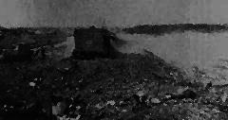
Patterns of Imagery
Death and ghosts
In chapter one, what does Nick, jokingly, tell Daisy is happening in Chicago to show how she is missed?
Complete this quotation from page 21: “Tom and Miss Baker, with several feet of twilight between them, strolled back into the library, as if to…..”
At the party in chapter two, Myrtle makes a lot of fuss about the shopping she has to do. Name the item on her shopping list which forms part of this death motif. (p38)
What is the only thought going through Myrtle’s mind after her first encounter with the sexually arrogant Tom Buchanan?
As the party-goers in chapter three gather around the car accident, there is a ‘______ pause’ as another figure emerges from the car and ‘the ________ stood swaying…’ (p55)
Tom says of Wilson: ‘He’s so dumb, he doesn’t know he’s alive.’ (p29)

Slide 11
AO3: Interpretations
“He [Wilson] is emotionally, economically and physically defeated by life, drained of vitality and identity….Wilson is a victim of a callous and indifferent society that casts the unsuccessful on to the rubbish heap of history.” (p40-41 The Great Gatsby. Penguin Critical Studies. Parkinson, K)
“The fabulous mansions of East and West Egg, together with the valley of ashes, represent alternative worlds of success and failure in a modern capitalist society…The two landscapes of wealth and poverty are reflections of each other, together signifying the moral identity of a society given over totally to indifference and escapism…Any reality which denies the validity of the imagination, and consequently is blind to the autonomous imagination of others, as are Tom and Daisy, is indeed in a valley of ashes.” (p64-65 The Great Gatsby. Penguin Critical Studies. Parkinson, K)

Slide 12
The Eyes of Dr T.J. Eckleberg
…above the grey land and the spasms of bleak dust
which drift endlessly over it, you perceive, after a
moment, the eyes of Doctor T. J. Eckleberg…[his]
eyes…are blue and gigantic – their retinas are one yard
high. They look out of no face, but, instead, from a pair
of enormous yellow spectacles which pass over a non
existent nose…his eyes, dimmed a little by many
paintless days, under sun and rain, brood on over the
solemn dumping group.
In groups, discuss what these giant eyes could symbolise. Think about:
Their setting overlooking the Valley of Ashes
The importance of advertising in society
Lack of vision
Symbol of God?

Slide 13
The Eyes of Dr T. J. Eckleberg
Reminds us – by its sheer size and the incongruity of its surroundings – of the importance and influence of advertising in modern culture. These eyes have no natural place on the hillside, and yet they dominate the landscape, being its most prominent feature.
Fitzgerald has deliberately chosen an advert for optometry in order to point out the modern man’s inability to see the corruption of our society and environment. This lack of vision applies to all of the characters in the book, each of all fail to ‘see’ the basic futility of their hopes and dreams.
The billboard shows how consumerism and materialism has taken the place of traditional spiritual values.

Slide 14
Revision Questions
Q1.
‘Myrtle Wilson cares more about appearances than any other character in the novel.’ To what extent do you agree with this statement? Back up your statement with examples from the text.
Q2.
Using Chapter 2 as a starting point, analyse the role of marriage in ‘The Great Gatsby’ and assess whether any of the romantic relationships in the novel can be considered a success. Refer to the text in your answer.

Slide 15
Home learning
Read chapter 4 and 5 – Wednesday!

Slide 16
The Building Blocks of Narrative
Scenes and places (i.e. narrative setting)
This refers to where the action is set and its wider significance.
Time and sequence (i.e. narrative structure)
The manipulation of time within the narrative, whether it is slowed down or accelerated. The sequence refers to the order in which events are shown.
Characters and characterisation
The people presented in the narrative along with their character traits and how they are revealed.
Voice (i.e. narrator, dialogue, etc.)
The way we get information in a narrative through what we are ‘told’ by the characters involved. Voices can help to establish character traits and so is a part of characterisation.
Point of view (i.e. narrative perspective)
The voice of the speaker within the narrative, usually either a narrator who is outside of the action, or a character within the story or poem. This can also be thought of as the standpoint or perspective from which the narrative is told.
Destination (i.e. overall significances)
If the purpose of a narrative is to take the reader on a journey, when you reach the end, you reach the destination. This may be delivering a moral message or asking the reader to make their own assumptions or conclusions.

