Slide 1
Entry task: target sheets
L.O.
To prepare a small presentation on a specific aspect of the text
DOPPELGANGERS
FRAME NARRATIVES
Using past essays, complete the sheet given to you. This is to be stored at the front of your folder, and will be referred back to.

Slide 2
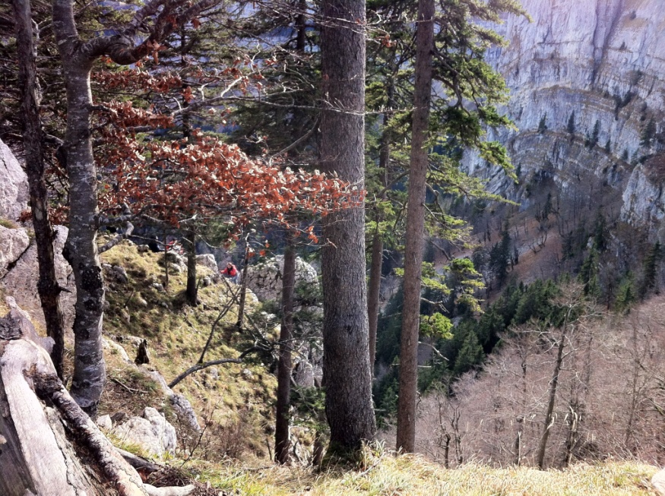
Outcomes:
All will have explored a specific narrative concept in relation to ‘Frankenstein’ generally.
Most will have used carefully selected quotations from Shelley’s novel to support ideas.
Some will have also incorporated new literary vocabulary into their ideas and explanations.

Slide 3
Task 1
In your groups, use your
booklet to consider your new
narrative concept. You will present this new idea
to the class in relation to Frankenstein.
GROUPS:
Ayub, Samatar: Shelley’s use of ‘doppelgangers’
Akhila, Hassrat: Shelley’s use of ‘The Frame Narrative’
Ravneet, Katerina, Dharmishta: Is Frankenstein Gothic?
Michala, Parminder, Hardeep: Language in Frankenstein

Slide 4
CHECKPOINT
Which outcomes will you
have achieved?
All will have explored a specific narrative concept in relation to ‘Frankenstein’ generally.
Most will have used carefully selected quotations from Shelley’s novel to support ideas.
Some will have also incorporated new literary vocabulary into their ideas and explanations.

Slide 5
Share what you have explored…
CLARITY OF COMMUNICATION…
AS IN THE CONNECTOR, BE CONCISE AND CLEAR!
All - how else could this idea relate to ‘Frankenstein’?
Most – what quotations from Shelley’s novel could be used to support these ideas?
Some – what literary terminology links to these ideas?

Slide 7
Home learning:
MUST: Using your new terminology sheet, ensure you arrive to tomorrow’s practice essay lesson ready to use some of these terms.
Extension: Have a look on 4od at the Shelley special!

Slide 8
WHICH AOs ARE TODAY’S OUTCOMES AIMED AT?
All – consider ideas such as doppelgangers, frame narratives, the Gothic and language in ‘Frankenstein’.
Most - use carefully selected quotations from Shelley’s novel
Some - incorporate literary vocabulary into your essay to analyse, express ideas and explain concepts.
CRITERIA (Band 6)
AO1 use of appropriate critical vocabulary and technically fluent style/well structured and coherent argument/always relevant with very sharp focus on task/confidently ranges around texts
AO2 exploration and analysis of key aspects of form, structure and language with perceptive evaluation of how they shape meanings
AO3 detailed and perceptive understanding of issues raised through connections between texts/perceptive consideration of different interpretations of texts with sharp evaluation of their strengths and weaknesses/excellent selection of supportive references
AO4 excellent understanding of a range of contextual factors with specific, detailed links between context/texts/task

Slide 9
DOPPELGANGERS
FRAME NARRATIVE
LANGUAGE
GOTHIC CONVENTIONS
Choose 1 or 2 small
sections of the text to
answer the following question:
How and why does Shelley use ?

Slide 10
REVIEW
Back to back questioning!
IN 5 WORDS DESCRIBE…
FRAME NARRATIVE
DOPPLEGANGERS
THE GOTHIC
MARY SHELLEY
THE SUBLIME

Slide 11
Chapter 20 – Victor’s internal meditations
They might even hate each other; the creature who already lived loathed his own deformity, and might he not conceive a greater abhorrence for it when it came before his eyes in the female form? She also might turn with disgust from him to the superior beauty of man; she might quit him, and he be again alone, exasperated by the fresh provocation of being deserted by one of his own species. Even if they were to leave Europe and inhabit the deserts of the new world, yet one of the first results of those sympathies for which the daemon thirsted would be children, and a race of devils would be propagated upon the earth who might make the very existence of the species of man a condition precarious and full of terror. Had I right, for my own benefit, to inflict this curse upon everlasting generations? I had before been moved by the sophisms of the being I had created; I had been struck senseless by his fiendish threats; but now, for the first time, the wickedness of my promise burst upon me; I shuddered to think that future ages might curse me as their pest, whose selfishness had not hesitated to buy its own peace at the price, perhaps, of the existence of the whole human race.

