Slide 1
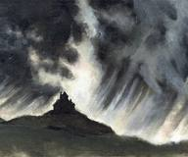
Horror v Terror

Slide 2
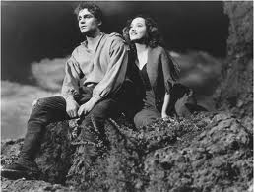
Background
The consensus of the difference between horror and terror has basically stayed the same since Ann Radcliffe laid out her idea of the argument in her posthumously published essay, On the Supernatural in Poetry.

Slide 3
AO3
“Terror and horror are so far opposite, that the first expands the soul, and awakens the faculties to a high degree of life; the other contracts, freezes, and nearly annihilates them.
Now, if obscurity has so much effect on fiction, what must it have in real life, when to ascertain the object of our terror, is frequently to acquire the means of escaping it.”

Slide 4
In plan English
We will say “I was terrified!” when telling a story which involves the fear of what might have happened, and we will say “I was horrified!” when we describe something unsettling which we have seen. In other words, terror is prevalent when not enough happens for the person to be “horrified” or completely unsettled by the situation, but he or she still knows enough to be afraid. Terror is the anticipation; horror is the reaction. However, you can have horror without first being terrified, just as you can be terrified without later obtaining a feeling of horror.

Slide 5
Horror vs Terror in Hitchcock’s “Psycho”
https://www.youtube.com/watch?v=8VP5jEAP3K4

Slide 6
Difference?
Terror comes from not knowing or uncertainty. Terror is much more of a psychological matter than horror.
Terror really makes you think. It in a sense makes you think about all the things that could go wrong, what could possibly be lurking around the corner or even how terrifying that monster really is. Where as horror is witnessing the actual monster, see a gruesome murder take place or whatever the circumstance may be.

Slide 7
Terror and Horror in WH?
Can you think of passages of terror and horror in WH?
Pick two passages in WH – one which elicits terror and one which elicits horror
Using the two passages answer the question, “WH tends to inspire more terror than horror”. How far do you agree with this statement?
Meet the AOs

Slide 8
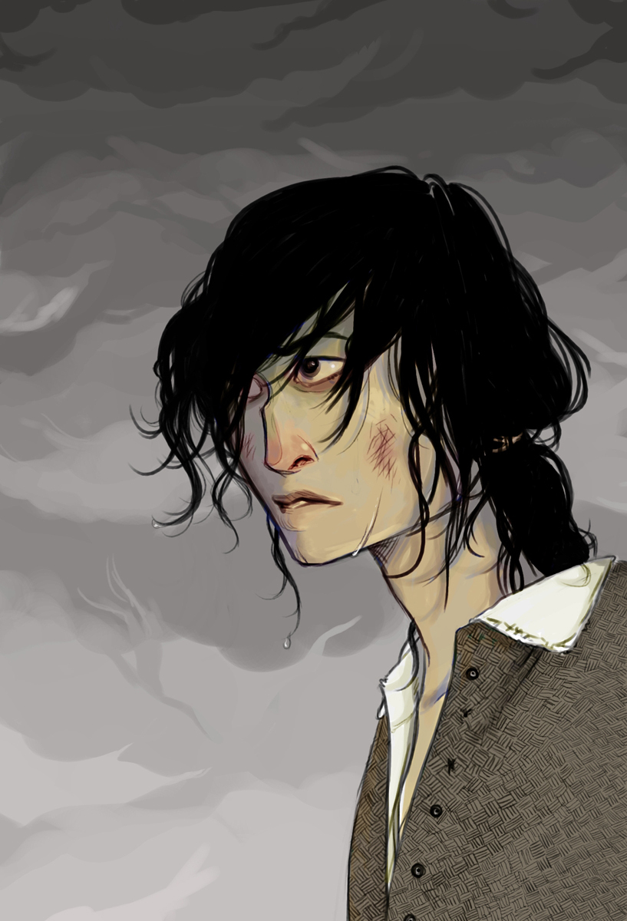
AO reminder
A01: Articulate creative, informed and relevant responses to literary texts, using appropriate terminology and concepts, and
coherent, accurate written expression.
A02: Demonstrate detailed critical understanding in analysing the ways in which structure, form and language shape meanings in literary texts.
A03: Explore connections and comparisons between different
literary texts, informed by the interpretations of other readers.
A04: Demonstrate understanding of the significance and influence of the contexts in which literary texts are written and received.

Slide 9
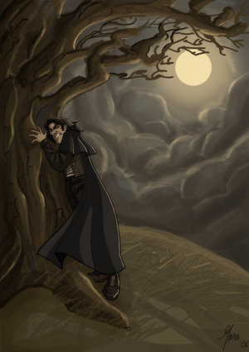
Review
If you were to rate different gothic elements in WH –what would you give each of the following out of 10?
Liminality ( The experience of being on a threshold or a boundary. Neither one thing or the other; the point of uncertainty and fluidity)
Isolated settings
Complex narrative
Death or bloody imagery
The supernatural
Taboos – cultural, moral, religious values violated
Horror
Terror
Byronic hero
Otherness

Slide 10
Homelearning
Find five instances of the supernatural in Wuthering Heights. Have at least five quotes with page numbers which you are ready to discuss.
http://scholarcommons.usf.edu/cgi/viewcontent.cgi?article=1494&context=etd
What is the role of the supernatural in Wuthering Heights?

