Slide 1
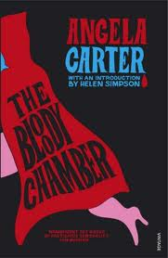
The Bloody Chamber
By Angela Carter 1979

Slide 2
Transforming Fairytales
LO: To use the exam criteria to explore, plan and write a practise answer on the Gothic
Big Picture:
Literary criticism and reviews
Traditional fairytale ‘Bluebeard’
Group work – close reading
Feedback
Review
Homelearning
Learning Outcomes:
All will understand how Carter has transformed a traditional fairytale
All will understand the essay question and mark criteria
Most will produce a close reading and annotate their text on their focus area
Most will understand the significance of Gothic conventions in their extract

Slide 3
“In The Bloody Chamber, childhood fairytales become the stuff of adult nightmares.” With close reference to ‘The Bloody Chamber’ say how far you agree with this comment. (40 marks) What AO’s are assessed for Section A?
AO1
AO2
AO3
AO4
Examiner’s report: “To score high marks, it is also important to address all parts of the question. Candidates are advised to consider the wording of questions very carefully ” January 2011.

Slide 4
Connector
Read the review below.
How do you think the first tale may relate to the Gothic?
What particularly intrigues you about this review?
Check any vocabulary you do not understand
Probably one of the most richly evocative tales I have read! A book of contemporary adaptations of the stories we all knew and loved as children. Carter challenges patriarchal society with devilish passion and dexterity. On a different level she succeeds in illustrating how seemingly innocent elements within popular culture (fairy tale) has in the past been able to influence the minds of its audience in terms of patriarchal values . Carter has introduced a complex twists, her tales are full of unanswered questions and loose ends and spine tingling confrontations. A fantastic cheeky book I’ve read over and over again, and eventually used as my dissertation topic for my degree. Brilliant!
The Bloody Chamber is an invoking novel, which reappropriates patriarchal western fairy tales, such as ‘Bluebeard’ , to challenge notions of male superiority and the objectification of women. Carter’s talent as a writer enables her to utilize the most vivid and violent use of imagery and language to demonstrate the way in which women have been exploited in western society. This powerful novel will appeal to all who are prepared to open their minds and accept feminist ideology over patriarchal ideas.
Carter manages to twist the once innocent fairy tales into short stories with endings that were certainly not expected. She challenges the structure of patriarchy as well as the literary structure of the fairy tale in such a way that makes you think. Dark, psychological, seductive, and sensual. A book I couldn't put down.

Slide 5
Fairy Tale or Gothic?
Critics have disagreed about whether The Bloody Chamber is a rewriting of the Gothic with fairy tale elements or a rewriting of the fairy tale with Gothic elements.
The two genres share many similarities – medieval setting, oral folk tale culture, a dangerous supernatural creature who threatens a young girl, transformative elements.
Before the stories were written down by men, the female characters were stronger and feistier – they only changed as cultural expectations of young women changed and the stories were used to teach young girls a lesson.
Carter’s heroines, like those of the original folk tales, refuse to be passive and frightened, refuse to become victims, and save themselves in whatever way they can.
Little Red Riding Hood transforms the wolf and makes him ‘tender’.
We are given new gendered characterisations different from the past but appropriate for the 1970s and beyond.

Slide 6
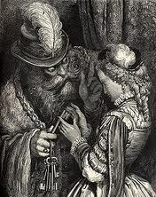
Source Text
‘The Bloody Chamber’ has many influences from the traditional French fairytale ‘Bluebeard’ by Charles Perrault.
Can you identify the conventional fairytale elements in the text?
Would you object to anything in the story?
Predict how Carter may use this as a source and transform into an “adult nightmare”

Slide 7
Close Readings
In small groups you will now closely analyse extracts from ‘The Bloody Chamber’.
Use the questions on your sheets to annotate the extract.
Remember the LO to be “able to prepare for a mock question.”
“In The Bloody Chamber, childhood fairytales become the stuff of adult nightmares.” With close reference to ‘The Bloody Chamber’ say how far you agree with this comment.

Slide 8
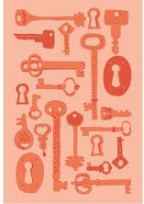
Feedback
“’In The Bloody Chamber’ childhood fairytales become the stuff of nightmares”
Violence
Sexuality
Challenges to the patriarchal system
Gothic elements

Slide 9
Model Essay

Slide 10
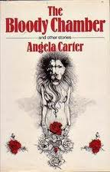
Written Task
Write your opening paragraph to your essay.
Examine the mark scheme to help you.
Extension:
Focus on an area other than the one you specifically studied.

Slide 11
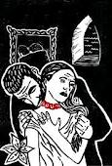
Homelearning
Read the whole of ‘The Bloody Chamber’
Complete the Tale Tracker sheet2

