Slide 1
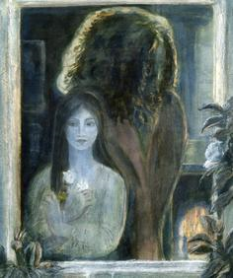
The Courtship of Mr Lyon
LO: To consider how Carter challenges conventional Gothic gender roles.
LO: To respond to advise from examiners by developing AO3 and the ability to engage in debate.

Slide 2
Connector
Recall: Mind map the ways in which women are conventionally represented in Gothic literature.
Connect: Answer the following question: How does Carter change the ways in which women are conventionally represented in Gothic literature?
Challenge: Find a key quotation from ‘The Courtship of Mr Lyon’ that demonstrates how Carter challenges traditional Gothic representations of men or women and annotate.
10 minutes and feedback in discussion

Slide 3
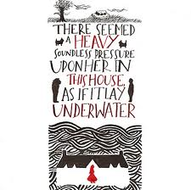
Examiner Report
“Examiners are pleased to see that many students are now engaging with debate and alternative readings in their writing. Many answers construct successful arguments and counter- arguments.” (AQA Report July 2012)
What are the key words in the examiner’s advise here?
What assessment objective needs to be developed to achieve this?

Slide 4
Feminist Gothic
15 minutes
Critical Input:
Firstly, read the literary criticism given to you from Gothic Literature by Sue Chaplin.
Highlight and annotate key words and ideas
Extend and Challenge:
Link to themes or characters in ‘The Courtship of Mr Lyon’ (for example the role of the father)
Use my model annotations and notes from the first page to help you.

Slide 5
Debate
5 minutes
“Carter challenges conventional Gothic gender roles in ‘The Courtship of Mr Lyon’”
Discuss
Write this question down.
Annotate:
What are the key words and what do they mean?
Note your initial ideas
Remember you need to provide a debate for the higher marks so some ideas on how Carter challenges conventional gender roles and some ideas on how she keeps them the same (or perhaps even reinforces them further)

Slide 6
Characterisation
30 minutes
Key Questions:
How is each initially portrayed?
How does the portrayal change to challenge gender roles?
How is the Gothic convention of female or male representation challenged?
Why has Carter done this?
Look at the key quotations on your worksheet and analyse using your understanding of conventional female representations (passive/virginal/weak) in Gothic literature and how Carter may challenge this.
The first has been done for you. I have demonstrated what is an effective annotation.

Slide 7
Debate
As a class debate the essay question.
“Carter challenges conventional Gothic gender roles in ‘The Courtship of Mr Lyon’”
Discuss
Rules:
-One person speaks at a time
-Pass on the debate by naming the next person to speak
Make it clear if you wish to contribute (hands up?)
Use your poker chips, you should aim to contribute at least 3 times
Use evidence from the text and from our critical research today

Slide 8
Review
Turn to the person sitting next to and explain how you will answer the question with:
A clear argument agreeing with the statement
A clear counter-argument

Slide 9
Homelearning
Complete the essay using your learning from today’s lesson.
At least 1.5 sides typed
Size 12 font maximum
Focus on AO3 – a variety of interpretations
Use the essay structure sheet if you need additional support
To be emailed or printed off before and handed in next lesson

