Slide 1
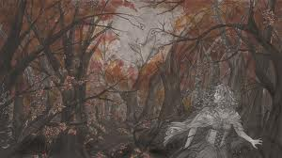
CONNECTOR
Analyse the images in front of you:
- Different interpretations
Significance
Include gothic terminology

Slide 2
The Gothic
Lesson Objectives:
To analyse The Erl-King, considering all assessment objectives.
To engage in a debate about the tale.

Slide 3
Task 1- Summary
Read the summary hand-out about the story.
Read the extracts of AO4 given to you.
Check out the critical writings – poem in relation to the story.

Slide 4
Task 2 – Annotate Quotes
Read and understand the quotes, analyse them, add your annotations; make them relevant.
Highlight key information and words
In groups – work together and share ideas and make clear annotations

Slide 5
DEBATE!!!

Slide 6
Review
Essay questions that you could answer –
Many readers have been shocked by the stories in The Bloody Chamber. Do you find them merely shocking? You should refer to at least two stories in your answer. (40 marks)
“In The Bloody Chamber Angela Carter reverses gothic traditions so that the males become the victims instead of the females.”Consider at least two of the stories in The Bloody Chamber in the light of this view.(40 marks)
“In the stories in The Bloody Chamber Carter is excessively interested in violent instincts.” How far do you agree with this view? (40 marks)

