Slide 1
Quotation Blast
5 minutes
The Courtship of Mr Lyon

Slide 2
Connector: Broken Pieces
Find a quotation to support each of the different readings for what the role of the witches may be in the play.
Role of the Witches | Supporting Evidence
The witches are included in ‘Macbeth’ to create a sense of mystery, secrecy and ambiguity.
The witches’ role is to create disorder and chaos to reflect Macbeth’s mental state.
The witches’ role is to reflect the very real fear society had over the supernatural.
The witches’ role is to decide the fate and destiny of Macbeth.
The witches’ role is to frighten and terrify the audience.
Extension: choose one broken piece and write a detailed analysis of the representation of the Witches.

Slide 3
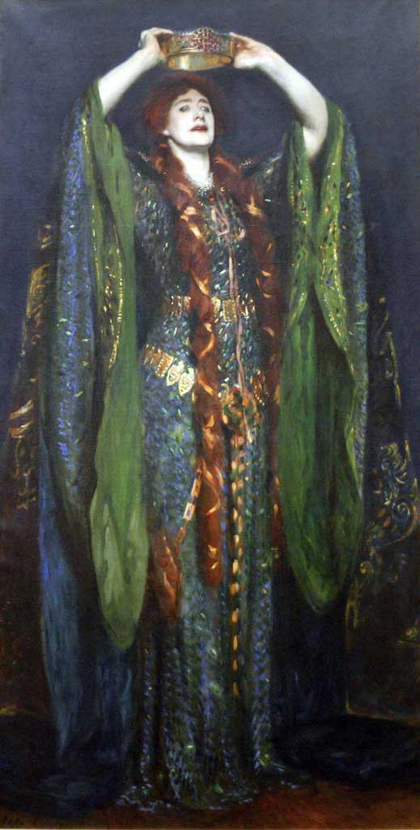
The Gothic Woman
Connector (AO3)
Read the extract on the Witches
Highlight parts you consider to be key
Make a list of the different things that the Witches represent
Rank the list in order of importance
From what you have read so far, how do the characters of the Witches link to the character of Lady Macbeth?

Slide 4
Reading Act 1, Scene 5 and 7
Let’s read together…

Slide 5
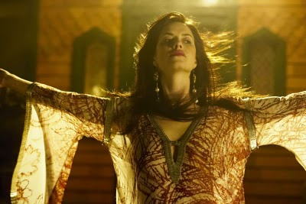
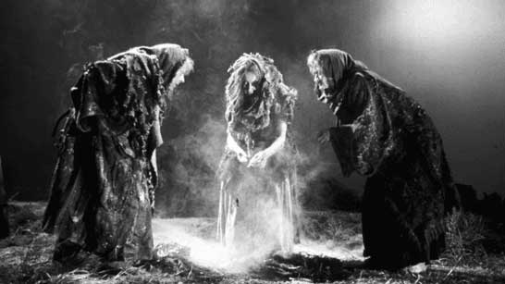
Lady Macbeth and the supernatural(AO2)
Analyse the quote given to you. Focus on AO2.
What do you learn about Lady Macbeth?
How does her character link to that of the Witches and the theme of the supernatural?
Be prepared to present to the rest of the class.

Slide 6
Fiend-like Queen Essay
Read the essay
Highlight key bits of information
Add further notes to your chart of quotes for Lady Macbeth?
On the back of your chart add further key quotes from A1, S5 or A1, S7. a

Slide 7
Lady Macbeth is a fiend-like queen.
Stand in a straight line in order of strongly agree (front of classroom) to strongly disagree (back of classroom)
You must discuss your viewpoints to ensure you are standing in the correct order.
Challenge: bend the line – bend the line in half so the 2 opposing ends are opposite each other, forming a tunnel. Have a discussion about the views held by the person opposite you.

Slide 8
Discussion Points
Review
Lady Macbeth is a fiend-like queen.
The mortals in Macbeth are more evil than the Witches. Think about what the Witches represent, what Lady Macbeth represents and the connection between them.
Macbeth is dominated by a woman who is prepared to renounce her femininity.
Macbeth’s will is weakened by speculation but Lady Macbeth’s will is strengthened by concentrating solely on the act of killing King Duncan.
Why does Shakespeare present Lady Macbeth as the stronger partner in the marriage?
Write a paragraph for your discussion point. Include AO1, 2, 3 and 4. Shade in all parts to show you are meeting all AOs.

