Slide 1
Homelearning
Read Act 1 Scenes 4-7 in detail.
Annotate your copy paying particular attention to the language Lady Macbeth uses and what this shows about her.

Slide 2
Quotation Blast
4 minutes
The Erl King

Slide 3
Home learning
To complete past exam question:
What do you think is the significance of the witches in Macbeth?
(40 marks)
Podcast:
http://www.tes.co.uk/teaching-resource/Witches-and-the-Supernatural-in-Macbeth-6072708/

Slide 4
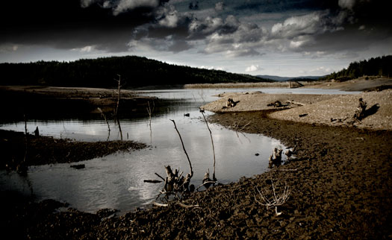
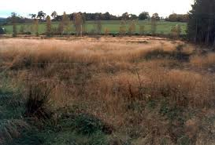
Connector:
Using your understanding of context from last lesson write a paragraph explaining the significance of the setting in the scenes featuring the witches.
Key Words:
Gothic
Setting
Shakespeare
Atmosphere
“A heath”
“A desolate place”
“A desolate place near Forres”
Desolate: Deserted of people and in a state of bleak and dismal emptiness

Slide 5
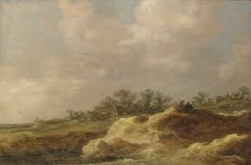
Extension: The Symbolism of the Heath
A heath or heathland is a shrubland habitat found mainly on low quality acidic soils, and is characterised by open, low growing woody vegetation
It is an open and desolate wilderness
Often used as a symbol or motif for madness, wildness and unruly, out of control nature.
Is not specific to place or time therefore making Shakespeare’s message universal
Pathetic fallacy can be easily incorporated to create an ominous and foreboding atmosphere
Can you add an additional 2 sentences to your paragraph using this information and analysis?
Key Words:
Symbolic
Wildness
Madness
Shakespeare

Slide 6
The Role of the Witches in ‘Macbeth’
LO: To identify the role of the witches in ‘Macbeth’ and analyse how this is revealed through their language
The Appearance of the Witches:
Act 1 Scene 1
Act 1 Scene 3
Act 3 Scene 5
Act 4 Scene 1
Extension: Skim and scan the text to find out when the witches appear in the play. Write down the Act and Scene

Slide 7
Act 1 Scene 1 A Desolate Place
Let’s explore their first appearance together
Thunder and lightning. Enter three WITCHES
First Witch
When shall we three meet again?
In thunder, lightening, or in rain?
Second Witch
When the hurly-burly's done,
When the battle's lost and won.
Third Witch
That will be ere the set of sun.
First Witch
Where the place?
Second Witch
Upon the Heath
Third Witch
There to meet Macbeth.
First Witch
I come, Graymalkin
Second Witch
Paddock calls
Third Witch
Anon.
All
Fair is foul, and foul is fair
Hover through the fog and filthy air
Task 1:
Get into 3s. You have 5 minutes to act it out!
Think about:
How do they move?
How do they speak?
What actions will you use?
The witches are arranging to meet Macbeth once he has finished in battle.
Task 2:
Let’s annotate this scene together.
Consider:
Pathetic fallacy
Juxtaposition
Chaos and disorder
use of rhyme
Paradox
Supernatural.

Slide 8
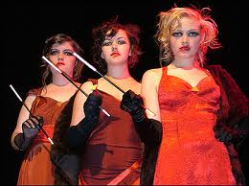
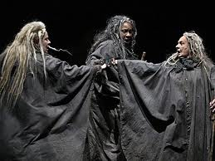
Group Work
20 minutes
You will now be split into groups.
We will be analysing Act I Scene III (half each).
Remember you are considering the role of the witches in the play.
Use the prompt questions to analyse the language.
Annotate and highlight your group extract.
You will teach the rest of the class later.

Slide 9
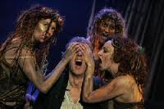
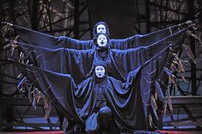
Feedback:
We will now feedback a group at a time and annotate our extracts with high level analysis.
What is happening in the scene?
What are the key quotes?
What can we analyse about the language?

Slide 10
Broken Pieces
Find a quotation to support each of the different readings for what the role of the witches may be in the play.
Role of the Witches | Supporting Evidence
The witches are included in ‘Macbeth’ to create a sense of mystery, secrecy and ambiguity.
The witches’ role is to create disorder and chaos to reflect Macbeth’s mental state.
The witches’ role is to reflect the very real fear society had over the supernatural.
The witches’ role is to decide the fate and destiny of Macbeth.
The witches’ role is to frighten and terrify the audience.
Extension: choose one broken piece and write a detailed analysis of the representation of the Witches.

Slide 11
The Witches’ impact on Macbeth and Banquo (discuss – 3 groups)
Why does Macbeth’s first line in the play, ‘so foul and fair a day I have not seen’ (lines 37) compel the audience?
How does Shakespeare make clear to the audience that the Witches are not a figment of Macbeth’s imagination? Why does he make this clear to the audience?
Macbeth meets the 3 Witches again in Act 4, Scene 1. The three apparitions given to Macbeth involve an armed head, a bloody child and a child crowned with a tree in his hand. How does this link to the gothic?

Slide 12
Review (exam question)
January 2010
What do you think is the significance of the witches in Macbeth? (40 marks)
Use the mark scheme for ideas
Focus on all AOs
All AOs must be highlighted or essays will be returned.

