Slide 1
Wuthering Heights
Lesson 1:
LO: To explore gothic patterns and iterative imagery and link to Bronte’s agenda
Key Words:
Gothic patterns: Gothic images or typical features that are repeated throughout the text, for example, the motif of blood in ‘Macbeth’
Iterative Imagery: Repeated images throughout the text which gain more meaning through repetition.
Agenda: What is Bronte’s purpose? What makes Wuthering Heights different?

Slide 2
A Synopsis
As you are reading the synopsis of the novel, begin to identify key gothic conventions within the plot and narrative.
Highlight and label aspects of the synopsis to support your ideas using the Key Conventions Booklet

Slide 3
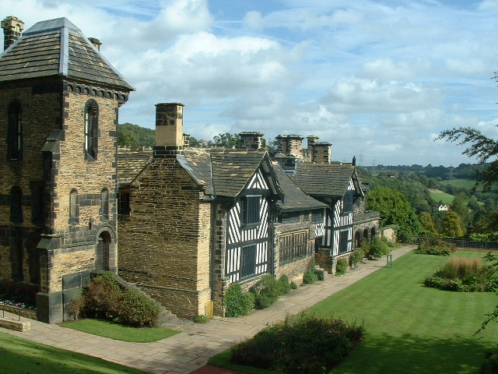
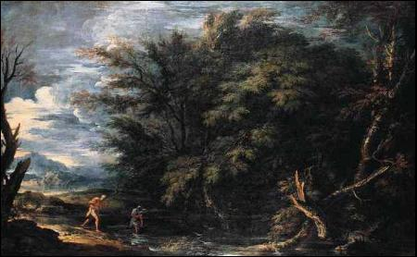
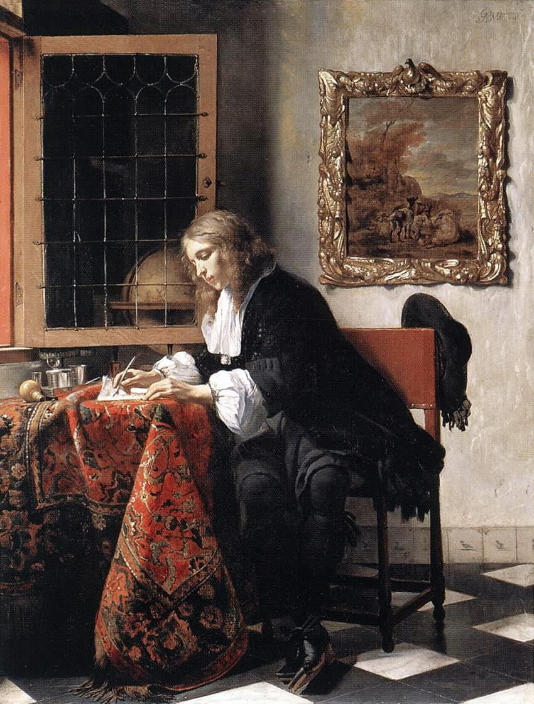
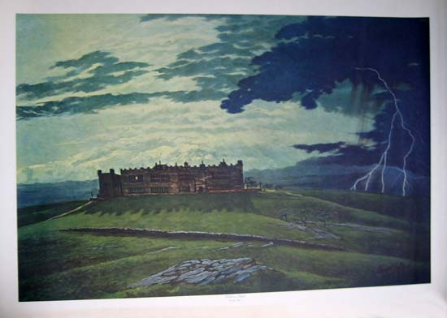
Where is the ‘Wuthering Heights’ in these images?

Slide 4
Floating Quotations: Pre-Reading Task:
Why?
As we read, we will find many gothic patterns and iterative imagery. This before reading task will give you a chance to explore these and prepare you for reading later.
Choose a quotation card from your pack
Read your quotation card and reflect on the foci
Discuss with a partner. Can you find any connections?
One sticker, one mover
Further discussion on foci
Foci:
Are there any repeated words or phrases?
Are there any images that have similar connotations?
Are there any strong contrasts?
Can you identify the key gothic conventions from the booklet?

Slide 5
Bronte’s Agenda
Look back at Carter’s Agenda as a reminder
10 – 5 – 3
Decide on 10 key aspects of Bronte’s Agenda
Highlight your top 5
Discuss you top 3 in detail with your partner

Slide 6
To what extent is Wuthering Heights a Gothic Novel?
You will need to ‘pitch’ to the rest of the group that your gothic feature is what makes Wuthering Heights a quintessentially gothic novel.
Each group will focus on a different extract and gothic feature.
Gothic Atmosphere and Setting: Nina and Amrit
Isolation of the Protagonist: Sagal and Sadik and Izzah
The Supernatural: Kerenjeet and Crystal

Slide 7
Your Pitch
Explanation:
Views are clearly developed and explained
Textual support is likely to be relevant and appropriately chosen
You are likely to provide only one side to the argument.
Analysis:
Views are developed with some depth
Textual support is likely to be very well chosen and wide ranging
You consider why the writer does depicts things in a certain way or why they use the form, language and structure used
you engage with the text and provide another interpretation as a result of your analysis
Evaluation:
a view or views are explored in depth
argument driven through to its conclusion
textual support is likely to be excellently selected and integrated
you consider the strengths and weaknesses of arguments put forth and provide varied interpretations
Success Criteria:
A confident exploration of key Gothic convention
Linking to ‘Macbeth’ and ‘The Bloody Chamber’
Analysis of language
Analysis of structure
Focus on gothic conventions

Slide 8
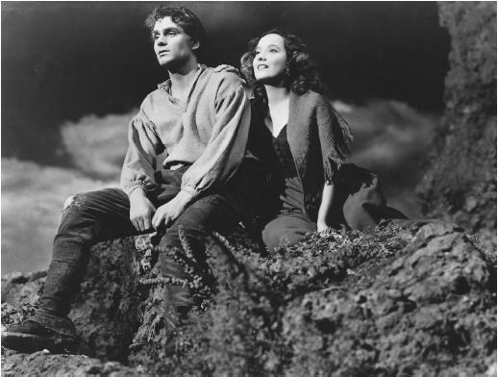
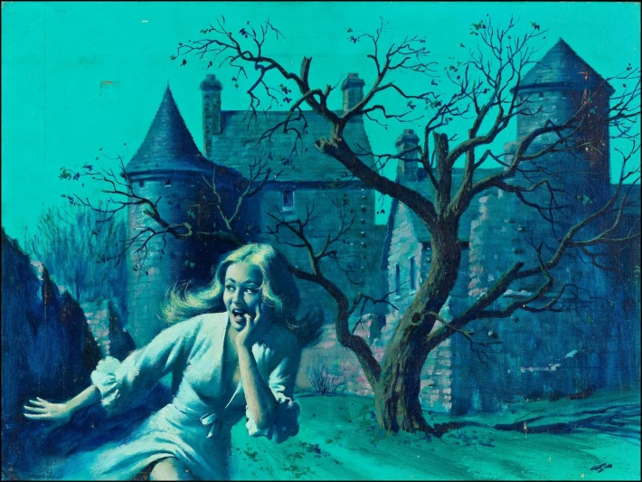
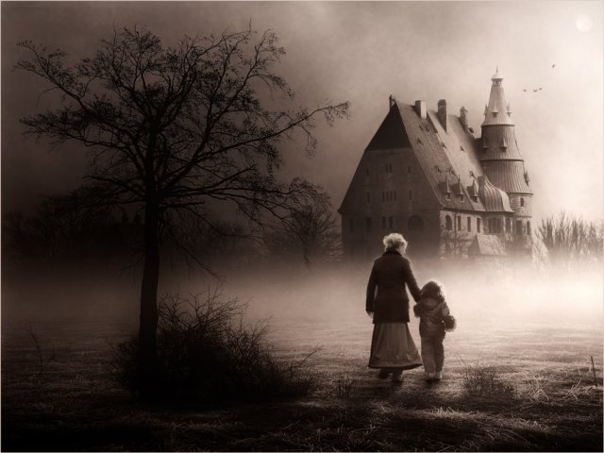
Review
Write a 50 words blurb for the novel to market it as a gothic novel drawing on the elements shared by the class.

Slide 9
Homelearning
Read Volume 1 of Wuthering Heights
Use the reading strategies from ‘Managing Reading’ whilst reading the text (Question box and post its)
Prepare for the first lesson back by completing the Weebly task on duel narrative

Slide 10
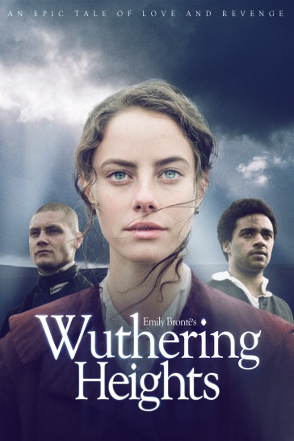
Key Gothic Conventions Booklet
Quotation Bank
As we study ‘Wuthering Heights’ gather key quotations under each of the key gothic convention headings.
Name: ___________________

Slide 11
Gothic Atmosphere and Settings
Gothic literature stresses an atmosphere of mystery, horror and dread. The plot involves hidden secrets which threaten the protagonist.

Slide 12
Isolation
The protagonists of Gothic literature are isolated or alone. That isolation could be physical (trapped in a house far from civilisation) or emotional (cut off from the people around her), and may either be self-imposed or a result of circumstances beyond her control.

Slide 13
Extreme of Emotion/ Melodrama
Emotions run high in Gothic literature. Characters are often passionate and strong-willed, defying others or even their own common sense in pursuit of their goals. Women are often curious and have a tendency to swoon, while men storm and rage in reflection of unseen inner torments.

Slide 14
Damsels in Distress
The "damsel in distress" motif appears quite often in Gothic literature, with women threatened by tyrannical men or just the circumstances in which they find themselves. They often appear frightened and may suffer from some kind of ailment.

Slide 15
The Supernatural
The supernatural often appears in Gothic literature, particularly ghosts and unexplained manifestations. In some Gothic novels, these elements ultimately have a rational explanation, but the implication always suggest something not of this world.

Slide 16
Foreboding
Ominous implications precede dark events in Gothic literature. Unlucky omens appear, ancient curses linger in the air, and dark forces beyond the hero's can thwart his ambitions.

Slide 17
Decay
The overall impression of a Gothic world is one of decay: a formerly great family, community, country or individual who has peaked and now begins a slow process of decline. This appears both in the landscape (crumbling buildings) and in the characters themselves.

Slide 18
Drama
The events in Gothic literature emphasise high emotion and often reflect a heightened sense of drama. Examples include murders, kidnappings, people going mad and tragic illnesses.

